Slide 1
Update on ratifications and notifications
WTO Secretariat
22 April 2021

Slide 2
ratification updates

Slide 3
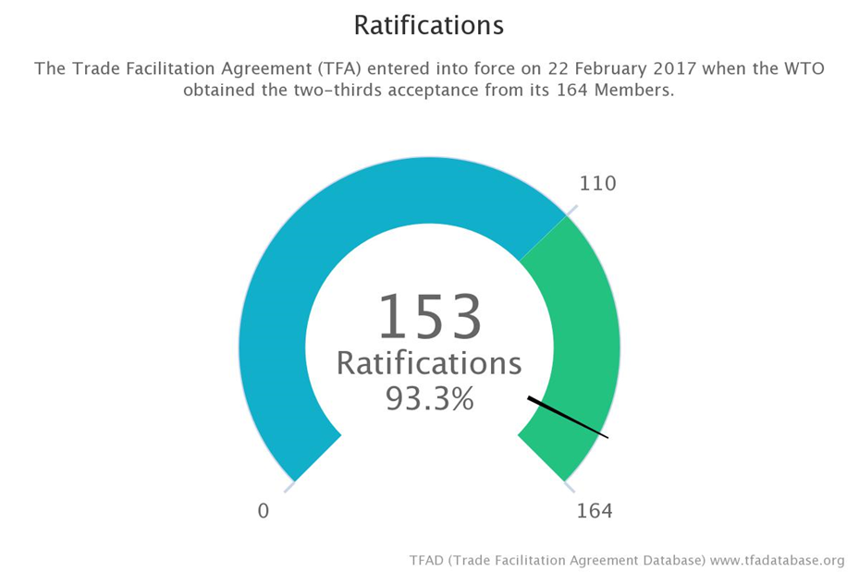
Ratifications presented
Ratifications yet to be presented
Democratic Republic of the Congo
Guinea-Bissau
Haiti
Liberia
Mauritania
Solomon Islands
Suriname
Tonga
Venezuela, Bolivarian Republic of
Yemen
European Union ratification: For the purposes of calculation of acceptances under Article X.3 of the WTO Agreement, an instrument of acceptance by the European Union for itself and in respect of its Member States shall be counted as acceptance by a number of Members equal to the number of Member States of the European Union which are Members to the WTO.

Slide 4
NOTIFICATION deadlines

Slide 5
LCD’s TO NOTIFY CATEGORY c definitive DATES BY 22/08/2022
NEXT NOTIFICATION DEADLINE
Out of the 32 LDC Members that have notified Category C designations to date:
7 Members have already notified all category C definitive dates ahead of the deadline:
Angola, Benin, Burundi, Democratic Republic of the Congo, Malawi, Mozambique and Zambia.
1 Member has notified some definitive dates ahead of the deadline:
Central African Republic
https://tfadatabase.org/notifications/implementation-dates/list/c

Slide 6
Status regarding notifications under expired deadlines that are yet to be submitted 2017 - 2021
Notifications yet to be submitted
Notification requirements and due dates | Developing Members | LDCs
ABC designations Developing countries by 22/02/2017 LDCs by 22/02/2018 | 3 | 3
Category B indicative dates LDCs by 22/02/2018 |  | 1
Category B definitive dates Developing countries by 22/02/2018 LDCs by 22/02/2020 5 LDC Members received an extension until 21/02/2021 | 1 | 2
Category C indicative dates LDCs by 22/02/2021 |  | 3
Category C definitive dates Developing countries by 22/08/2019 | 3
Category C TA requirements Developing members by 22/02/2017 LDCs by 22/02/2019 | 4 | 7
https://tfadatabase.org/notifications-matrix
Notes:
Category C TA needs:
7 are now missing from LDCs, one down from last time when we reported 8.

Slide 7
Status regarding information on donor arrangements and tacb progress
Information on Technical Assistance
Donor arrangements and progress on the provision of TACB
95
87
14
Members have notified Cat. C designations
Members have notified TA requirements
Members have notified Donor arrangements and TA progress
So far no notifications on Arrangements + Progress have been received by Donor Members
https://tfadatabase.org/notifications-matrix
Notes:
Developing Members will inform the Trade Facilitation Committee of their Donor arrangements by 22/02/2018 and LDCs by 22/02/2021 - Also Donors
Developing Members will inform the Trade Facilitation Committee of their progress in the provision of TACB by 22/08/2019 and LDCs by 22/08/2022 – Also Donors

Slide 8
Implementation progress

Slide 9
IMPLEMENTATION NOTIFICATIONS ARTICLES 15 & 16
13 notifications received since the last meeting:
Burundi G/TFA/N/BDI/1/Add.1
G/TFA/N/BDI/2
Cambodia G/TFA/N/KHM/4
Chad G/TFA/N/TCD/1/Add.1
LAO PEOPLE'S DEMOCRATIC REPUBLIC G/TFA/N/LAO/3
LESOTHO G/TFA/N/LSO/2
Madagascar G/TFA/N/MDG/3
G/TFA/N/MDG/3/Corr.1
G/TFA/N/MDG/3/Corr.2
Nepal G/TFA/N/NPL/1/Add.2
Niger G/TFA/N/NER/4
Senegal G/TFA/N/SEN/4
Tanzania G/TFA/N/TZA/2/Add.1

Slide 10
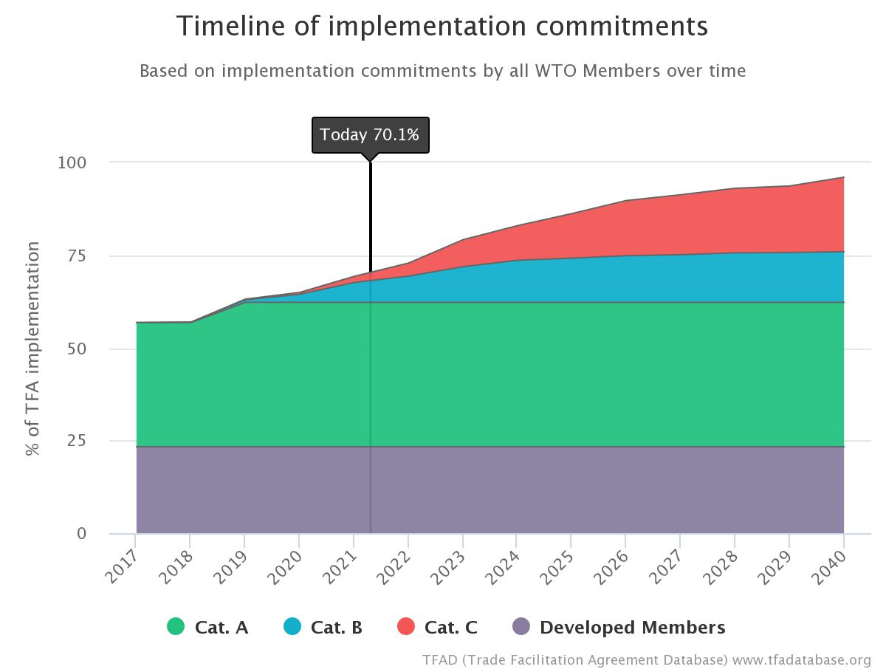
The Rate of tfa implementation commitments for the entire membership stands at 70.1% to date according to notification data and developed members commitments
https://tfadatabase.org/implementation
Notes:
These figures represent the current rate of implementation commitments by all WTO Members (developed, developing and LDCs).
Collectively, these commitments provide a roadmap of when the TFA can be expected to be fully implemented by the entire membership.

Slide 11
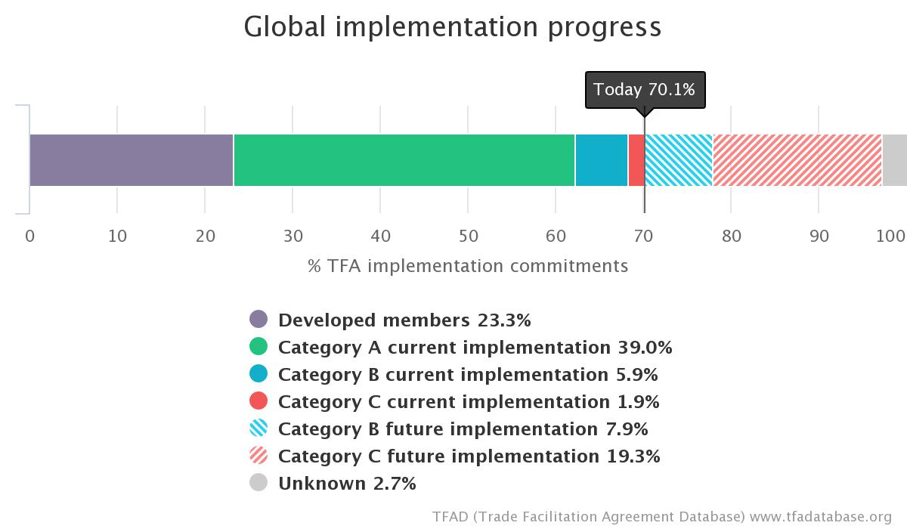
Status of implementation commitments according to notification data and developed Members commitments
https://tfadatabase.org/implementation
Notes:
This chart shows the current and future implementation commitments by type of commitment

Slide 12
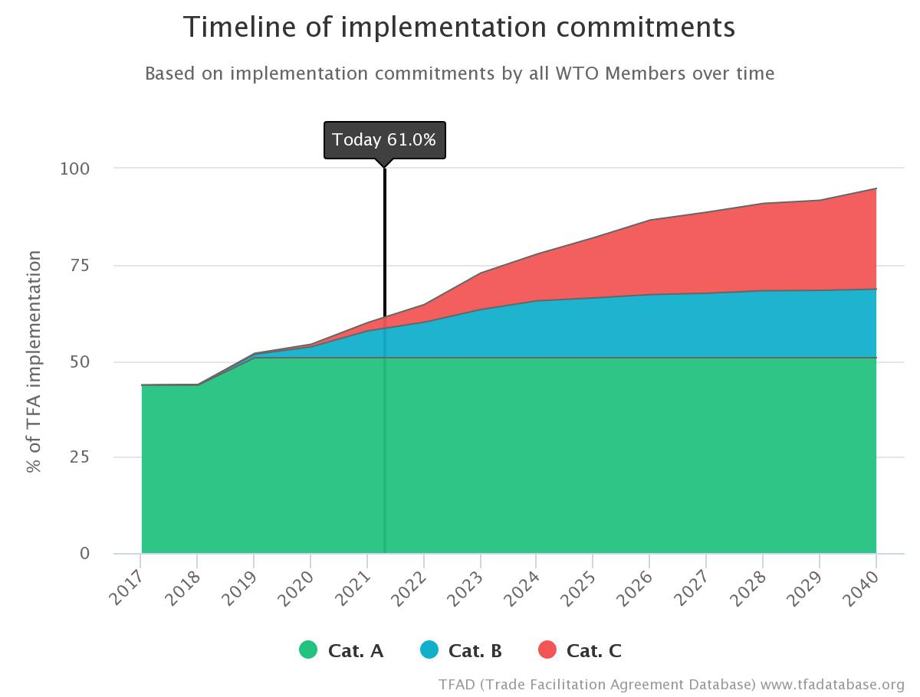
The Rate of tfa implementation commitments OF DEVELOPING + LDCs members stands at 61% to date according to notification data
Notes:
These figures represent the current rate of implementation commitments by developing and LDCs.
Collectively, these commitments provide a roadmap of when the TFA can be expected to be fully implemented by the entire membership.

Slide 13
Status of implementation commitments for developing countries and LDCs according to notification data
https://tfadatabase.org/implementation
Notes:
This chart shows the current and future implementation commitments for developing and LDC Members only

Slide 14
Rate of TFA implementation commitments
Timeline
Developed, developing and LDCs
To date
2021-2023
2024-2027
2028onwards
unknown
70%
83%
+13%
93%
+10%
96%
+3%
4%
Not yet notified
According to notification data and developed Members commitments
Notes:
Timeline counting develop, developing + LDCs
Implementation commitments span from 2017 to 2040
Methodology: we count developed Members commitments + definitive dates first if these have been notified. If not, we count indicative dates.

Slide 15
Rate of TFA implementation commitments
Timeline
Developing and LDCs
To date
2021-2023
2024-2027
2028onwards
unknown
61%
78%
+17%
91%
+13%
95%
+4%
5%
Not yet notified
According to notification data
Notes:
Timeline counting developing + LDCs only
Implementation commitments span from 2017 to 2040
Methodology: definitive dates first if these have been notified. If not, we count indicative dates.

Slide 16
Transparency

Slide 17
10 transparency notifications since the last meeting
Article1.4
Article10.4.3
Article10.6.2
Article12.2.2
10
7
6
5
Notes:
Note: we are counting notifications and not members

Slide 18
Technical assistance and capacity building

Slide 19
8 notifications since the last meeting
Articles 22.1 & 22.2
Article 22.3
1
7
Notes:
We are counting notifications and not Members.

Slide 20
Update on ratifications and notifications
Thank you
WTO Secretariat
22 April 2021

